Slide 1

Dimension Reduction PCA, tSNE, UMAP, Integration
v2023-02
Simon Andrews
simon.andrews@babraham.ac.uk

Slide 2
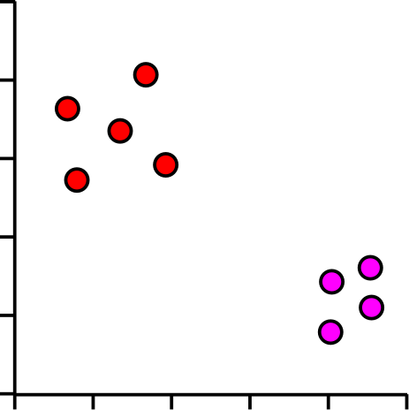
Where are we heading?
Gene | Description | Cell 1 | Cell 2 | Cell 3 | Cell 4 | Cell 5
Inpp5d | inositol polyphosphate-5-phosphatase D | 7.00 | 5.45 | 5.89 | 6.03 | 5.75
Aim2 | absent in melanoma 2 | 3.01 | 4.37 | 4.59 | 4.38 | 4.18
Gldn | gliomedin | 3.48 | 3.63 | 4.61 | 4.70 | 4.74
Frem2 | Fras1 related extracellular matrix protein 2 | 4.75 | 4.66 | 3.46 | 3.74 | 3.45
Rps3a1 | ribosomal protein S3A1 | 6.10 | 7.23 | 7.44 | 7.36 | 7.34
Slc38a3 | solute carrier family 38, member 3 | 1.90 | 3.16 | 3.52 | 3.61 | 3.19
Mt1 | metallothionein 1 | 5.07 | 6.49 | 6.46 | 6.04 | 6.05
C1s1 | complement component 1, s subcomponent 1 | 2.74 | 3.02 | 3.86 | 4.10 | 4.10
Cds1 | CDP-diacylglycerol synthase 1 | 4.55 | 4.22 | 3.80 | 3.16 | 3.12
Ifi44 | interferon-induced protein 44 | 4.82 | 4.52 | 3.87 | 3.42 | 3.59
Lefty2 | left-right determination factor 2 | 6.95 | 6.28 | 5.88 | 5.60 | 5.61
Fmr1nb | fragile X mental retardation 1 neighbor | 4.28 | 2.78 | 3.10 | 3.25 | 2.57
Tagln | transgelin | 7.93 | 7.91 | 7.20 | 7.02 | 6.68
Each dot is a cell
Groups of dots are similar cells
Separation of groups could be interesting biology

Slide 3
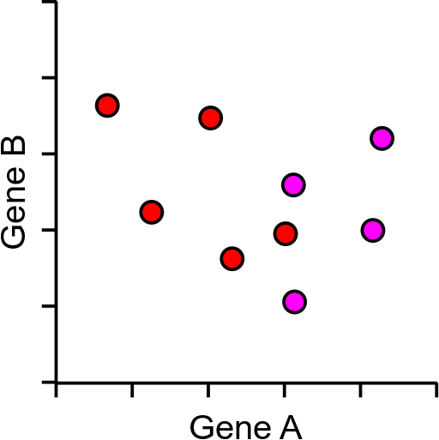
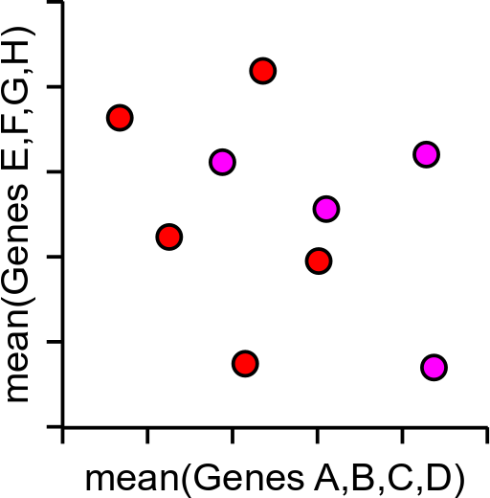
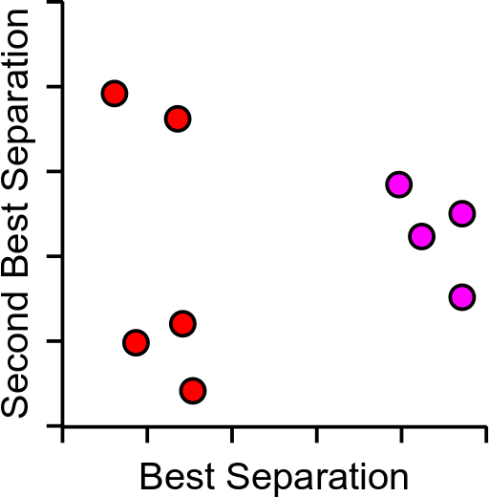
Too much data!
5000 cells and 2500 measured genes
Realistically only 2 dimensions we can plot (x,y)

Slide 4
Principle Components Analysis
Method to optimally summarise large multi-dimensional datasets
Can find a smaller number of dimensions (ideally 2) which retain most of the useful information in the data
Builds a recipe for converting large amounts of data into a single value, called a Principle Component (PC), eg:
PC = (GeneA*10)+(GeneB*3)+(GeneC*-4)+(GeneD*-20)…

Slide 5
Principle Components Analysis
Method to optimally summarise large multi-dimensional datasets
Can find a smaller number of dimensions (ideally 2) which retain most of the useful information in the data
Builds a recipe for converting large amounts of data into a single value, called a Principle Component (PC), eg:
PC = (GeneA*10)+(GeneB*3)+(GeneC*-4)+(GeneD*-20)…

Slide 6
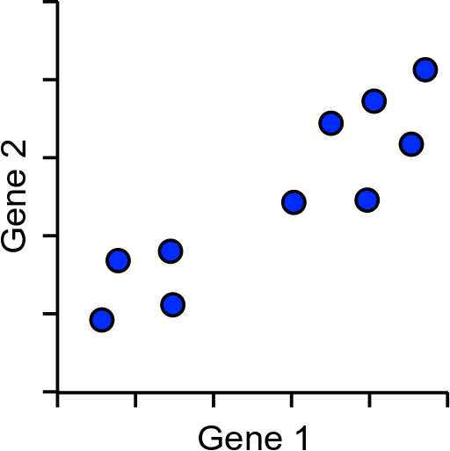
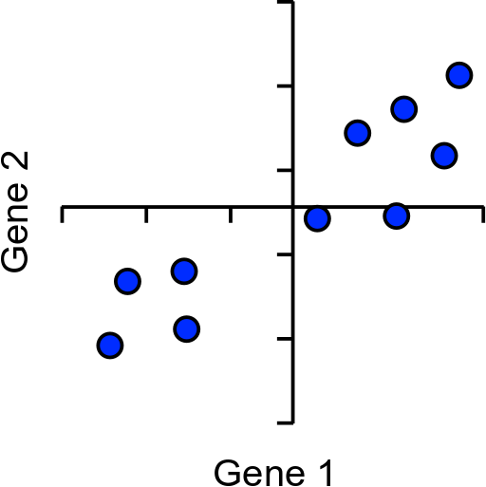
How does PCA work?
Simple example using 2 genes and 10 cells

Slide 7
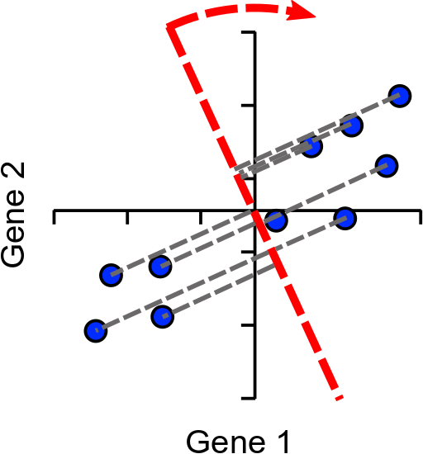
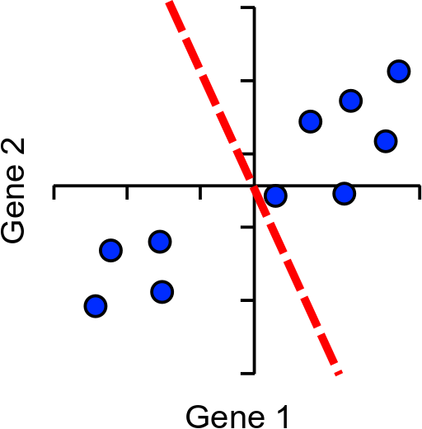
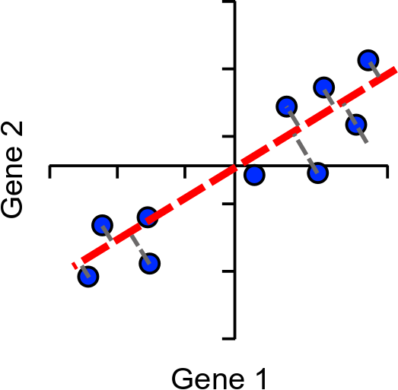
How does PCA work?
Find line of best fit, passing through the origin

Slide 8
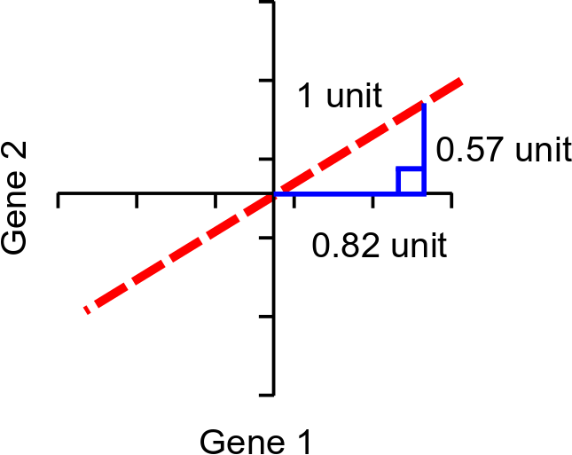
Assigning Loadings to Genes
Single Vector or
‘eigenvector’
Loadings:
Gene1 = 0.82
Gene2 = 0.57
Higher loading equals more influence on PC

Slide 9
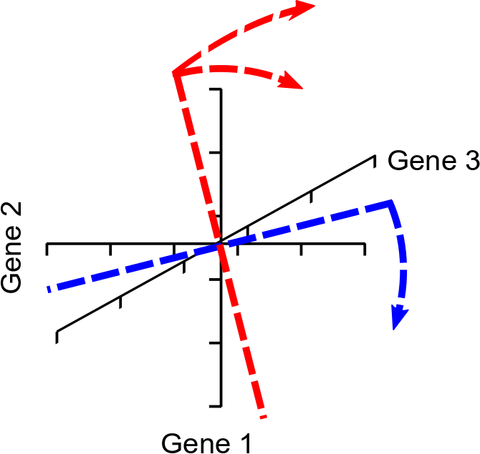
More Dimensions
The same idea extends to larger numbers of dimensions (n)
First PC rotates in (n-1) dimensions
Next PC is perpendicular to PC2, but rotated similarly (n-2)
Last PC is remaining perpendicular (no choice)
Same number of PCs as genes

Slide 10
Explaining Variance
Each PC always explains some proportion of the total variance in the data. Between them they explain everything
PC1 always explains the most
PC2 is the next highest etc. etc.
Since we only plot 2 dimensions we’d like to know that these are a good explanation
How do we calculate this?

Slide 11
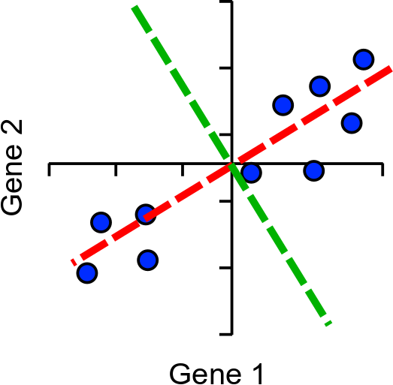
Explaining variance
Project onto PC
Calculate distance to the origin
Calculate sum of squared differences (SSD)
This is a measure of variance called the ‘eigenvalue’
Divide by (points-1) to get actual variance
PC1
PC2

Slide 12
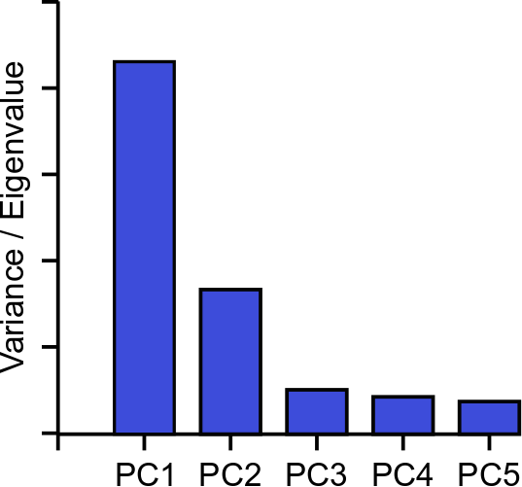
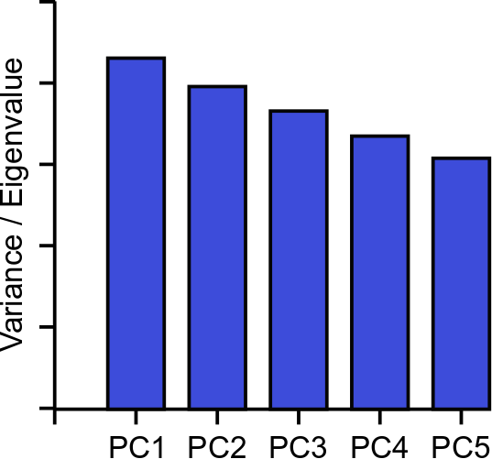
Explaining Variance – Scree Plots

Slide 13
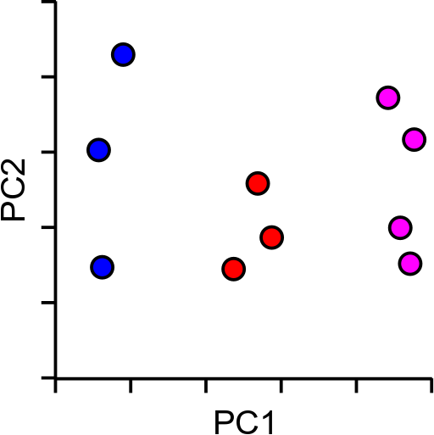
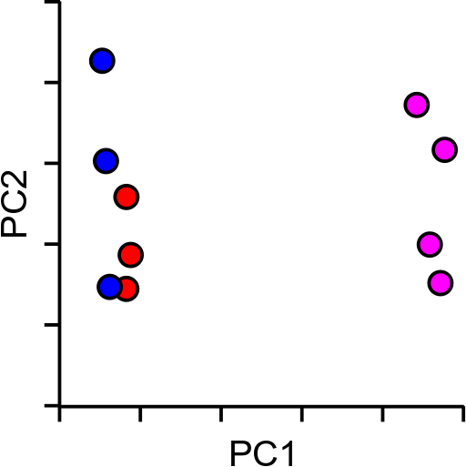
So PCA is great then?
Kind of…
Non-linear separation of values

Slide 14
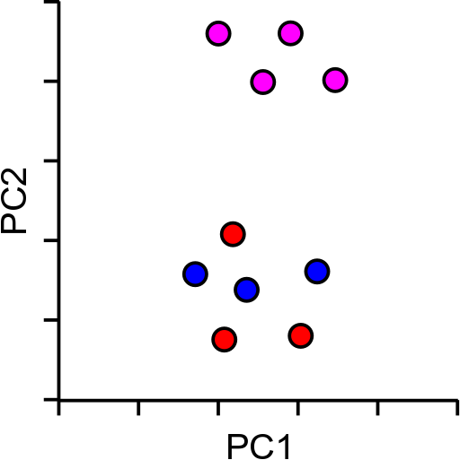
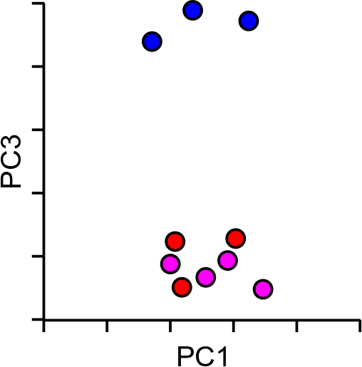
So PCA is great then?
Kind of…
Not optimised for 2-dimensions

Slide 15
tSNE to the rescue…
T-Distributed Stochastic Neighbour Embedding
Aims to solve the problems of PCA
Non-linear scaling to represent changes at different levels
Optimal separation in 2-dimensions

Slide 16
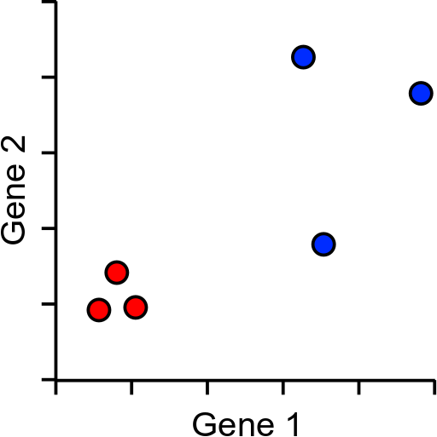
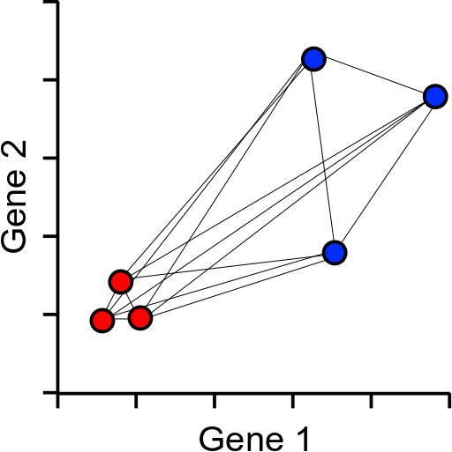
How does tSNE work?
Based around all-vs-all table of pairwise cell to cell distances

Slide 17
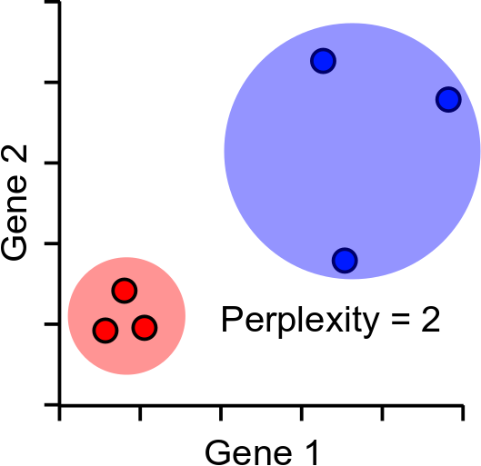
Distance scaling and perplexity
Perplexity = expected number of neighbours within a cluster
Distances scaled relative to perplexity neighbours

Slide 18
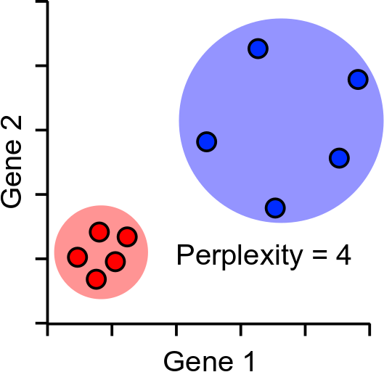
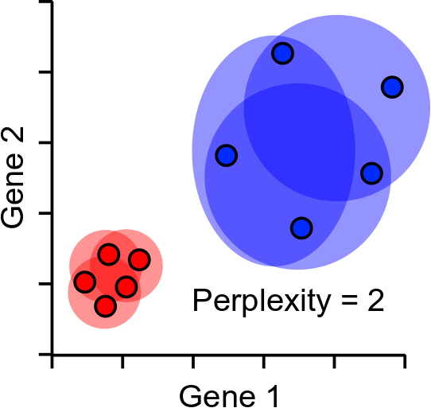
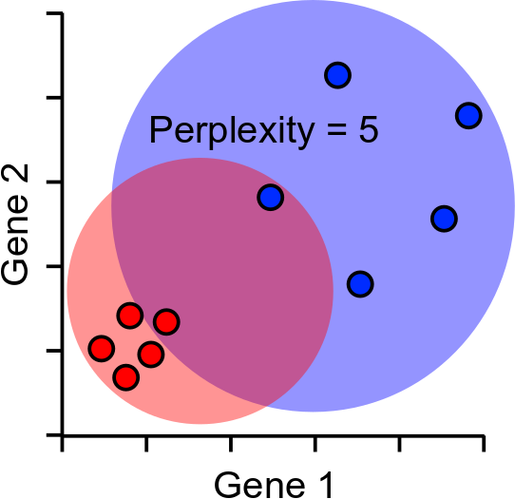
Perplexity Robustness

Slide 19
tSNE Projection
Randomly scatter all points within the space (normally 2D)
Start a simulation
Aim is to make the point distances match the distance matrix
Shuffle points based on how well they match
Stop after fixed number of iterations, or
Stop after distances have converged

Slide 20
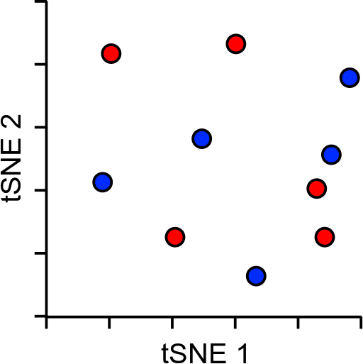
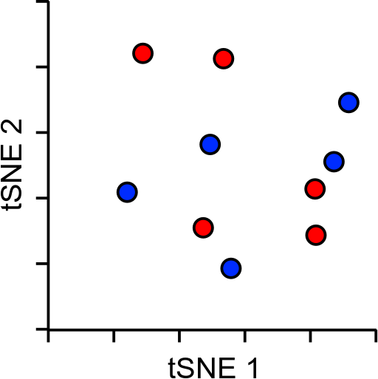
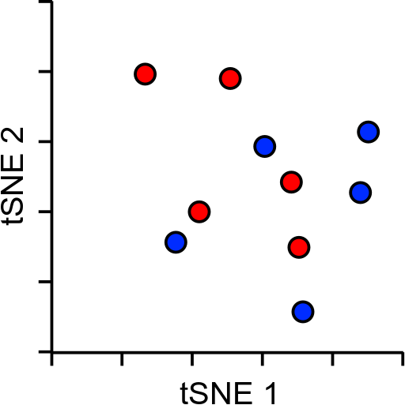
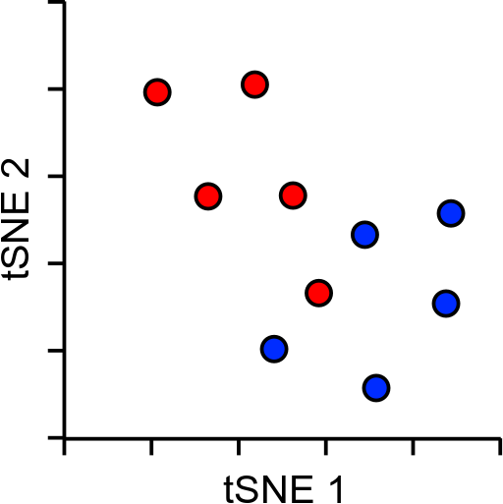
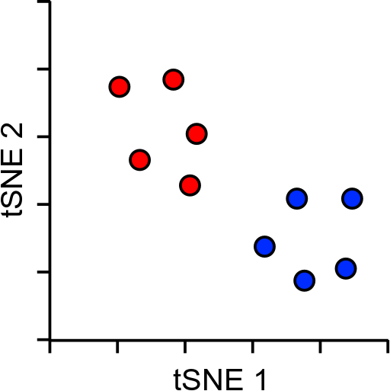
tSNE Projection
X and Y don’t mean anything (unlike PCA)
Distance doesn’t mean anything (unlike PCA)
Close proximity is highly informative
Distant proximity isn’t very interesting
Can’t rationalise distances, or add in more data

Slide 21
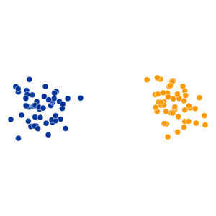
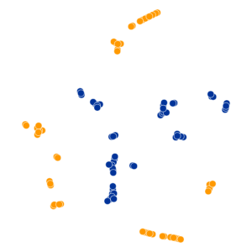
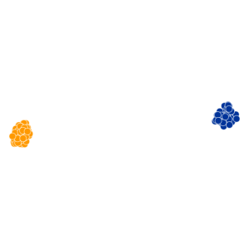
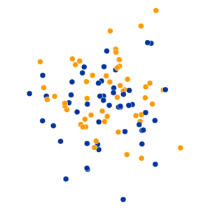
tSNE Practical Examples
Perplexity Settings Matter
Original
Perplexity = 2
Perplexity = 30
Perplexity = 100
https://distill.pub/2016/misread-tsne/

Slide 22
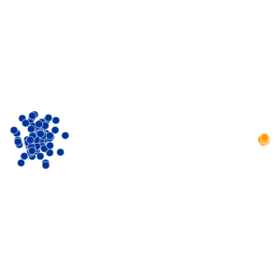
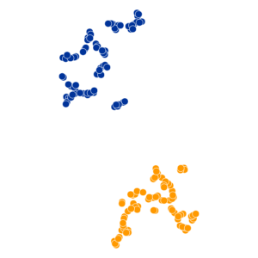
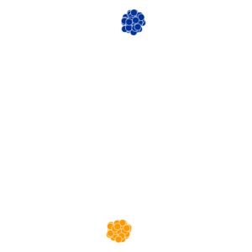
tSNE Practical Examples
Cluster Sizes are Meaningless
Original
Perplexity = 5
Perplexity = 50
https://distill.pub/2016/misread-tsne/

Slide 23
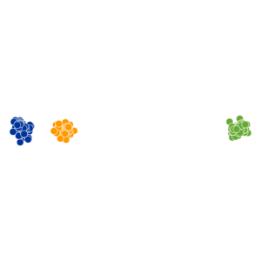
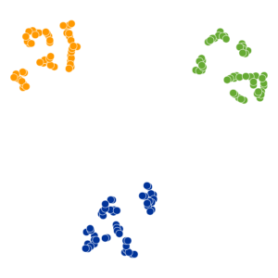
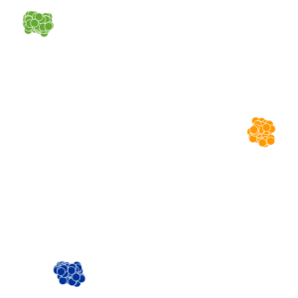
tSNE Practical Examples
Distances between clusters can’t be trusted
Original
Perplexity = 5
Perplexity = 30
https://distill.pub/2016/misread-tsne/

Slide 24
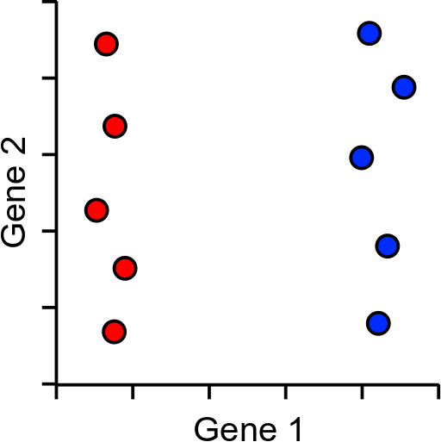

So tSNE is great then?
Kind of…
Imagine a dataset with only one super informative gene
Now 3 genes
Now 3,000 genes
Everything is the same distance from everything
Distance within cluster = low
Distance between clusters = high
Distance within cluster = higher
Distance between clusters = lower

Slide 25
So everything sucks?
PCA
Requires more than 2 dimensions
Thrown off by quantised data
Expects linear relationships
tSNE
Can’t cope with noisy data
Loses the ability to cluster
Answer: Combine the two methods, get the best of both worlds
PCA
Good at extracting signal from noise
Extracts informative dimensions
tSNE
Can reduce to 2D well
Can cope with non-linear scaling
This is what many pipelines do in their default analysis

Slide 26
So PCA + tSNE is great then?
Kind of…
tSNE is slow. This is probably it’s biggest crime
tSNE doesn’t scale well to large numbers of cells (10k+)
tSNE only gives reliable information on the closest neighbours large distance information is almost irrelevant

Slide 27
UMAP to the rescue!
UMAP is a replacement for tSNE to fulfil the same role
Conceptually very similar to tSNE, but with a couple of relevant (and somewhat technical) changes
Practical outcome is:
UMAP is quite a bit quicker than tSNE
UMAP can preserve more global structure than tSNE*
UMAP can run on raw data without PCA preprocessing*
UMAP can allow new data to be added to an existing projection
* In theory, but possibly not in practice

Slide 28
UMAP differences
Instead of the single perplexity value in tSNE, UMAP defines
Nearest neighbours: the number of expected nearest neighbours – basically the same concept as perplexity
Minimum distance: how tightly UMAP packs points which are close together
Nearest neighbours will affect the influence given to global vs local information. Min dist will affect how compactly packed the local parts of the plot are.

Slide 29
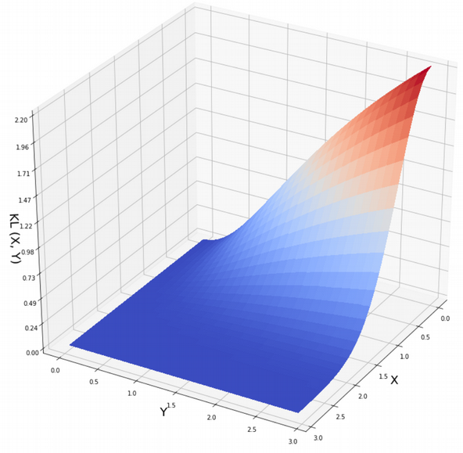
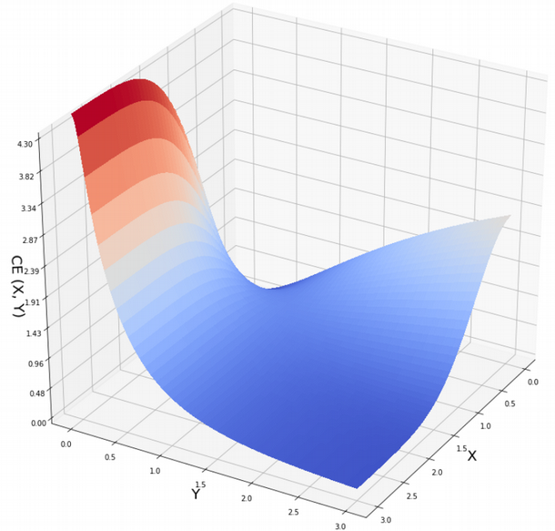
UMAP differences
Structure preservation – mostly in the 2D projection scoring
Scoring
(penalty)
value
Distance in
projected data
Distance in
original data
tSNE
UMAP
https://towardsdatascience.com/how-exactly-umap-works-13e3040e1668

Slide 30
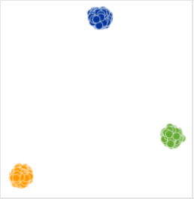
So UMAP is great then?
Kind of…
tSNE
UMAP

Slide 31
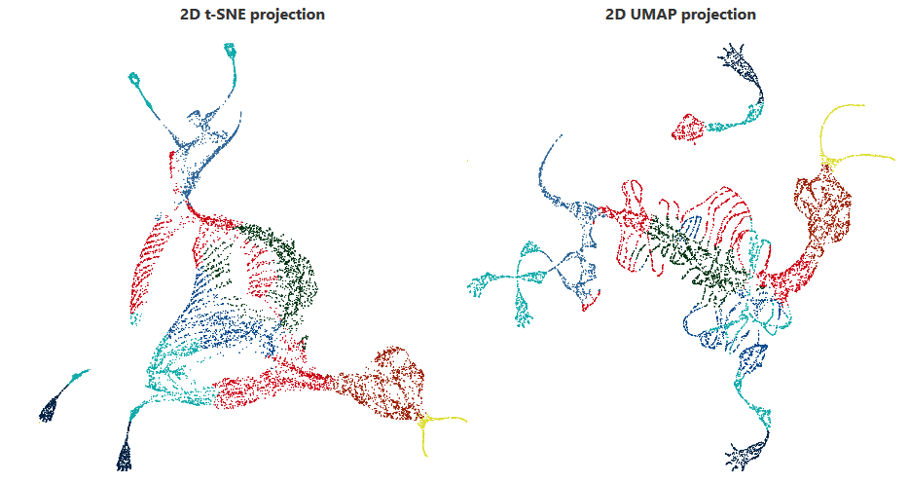
So UMAP is all hype then?
No, it really does better for some datasets…
3D mammoth skeleton projected into 2D
tSNE: Perplexity 2000 2h 5min
UMAP: Nneigh 200, mindist 0.25, 3min
https://pair-code.github.io/understanding-umap/

Slide 32
Practical approach PCA + tSNE/UMAP
Filter heavily before starting
Nicely behaving cells
Expressed genes
Variable genes
Do PCA
Extract most interesting signal
Take top PCs. Reduce dimensionality (but not to 2)
Do tSNE/UMAP
Calculate distances from PCA projections
Scale distances and project into 2-dimensions

Slide 33
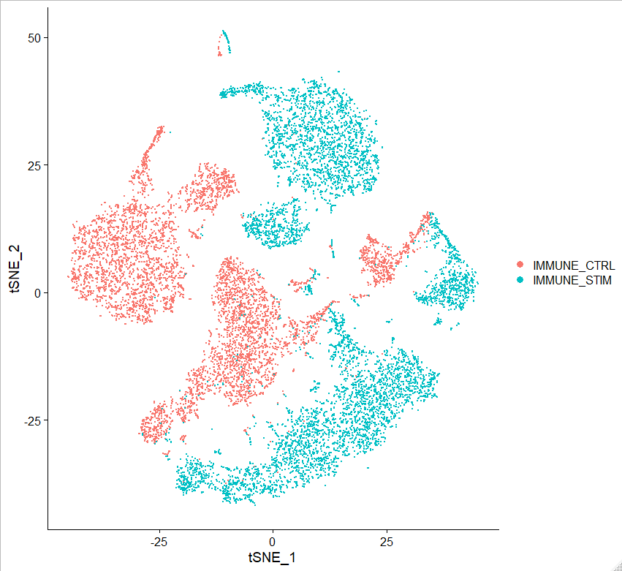
So PCA + UMAP is great then?
Kind of… as long as you only have one dataset
In 10X every library is a 'batch'
More biases over time/distance
Biases prevent comparisons
Need to align the datasets

Slide 34
Data Integration
Works on the basis that there are 'equivalent' collections of cells in two (or more) datasets
Find 'anchor' points which are equivalent cells which should be aligned
Quantitatively skew the data to optimally align the anchors

Slide 35
UMAP/tSNE integration
Define key 'anchor' points between equivalent cells

Slide 36
UMAP/tSNE integration
Skew data to align the anchors

Slide 37
Defining Integration Anchors
Mutual Nearest Neighbours (MNN)
For each cell in data1 find the 3 closest cells in data2

Slide 38
Defining Integration Anchors
Mutual Nearest Neighbours (MNN)
Do the same thing the other way around

Slide 39
Defining Integration Anchors
Mutual Nearest Neighbours (MNN)
Select pairs of cells which are in others nearest neighbour groups

Slide 40
Defining nearest neighbours
Distance in original expression quantitation
Really noisy (different technology, normalisation, depth)
Slow and prone to mis-prediction
Use a cleaner (less noisy) representation
Correlation (CCA)
Principal Components (rPCA)

Slide 41
Defining Nearest Neighbours
Canonical Correlation Analysis
Cells
Cells
Genes
Genes
DataSet 1
DataSet 2
Gene Expression Values may match poorly, but gene correlations are more robust

Slide 42
Defining Integration Anchors
Reciprocal PCA
Define PCA Space for Data 1
Define PCA Space for Data 2
Repeat by projecting Data1 into Data2 PCA space
Find mutual nearest neighbours
Project cells from data 2 into the data1 PCA space
PC1
PC1
Find nearest neighbours
PC2
PC2

Slide 43
Factors Affecting Integration
Which genes are submitted to the integration
Expressed in all datasets
Variable in all datasets
Which method is used to define nearest neighbours
Normalised data, Correlation, Reverse PCA
How many nearest neighbours you consider
Default is around 5, some clusters require more (20ish)
Other filters to remove artefacts

